Slide 1
WILD ANIMALS
divoká zvířata

Slide 2
GIRAFFE

Slide 3
LION [ˈlaɪən]

Slide 4
PARROT [ˈpærət]

Slide 5
SPIDER [ˈspaɪdə]

Slide 6
PENGUIN [ˈpeŋgwɪn]

Slide 7
ZEBRA [ˈzebrə]

Slide 8
TURTLE [ˈtɜːtəl]

Slide 9
ELEPHANT [ˈelɪfənt]

Slide 10
SNAKE [sneɪk]

Slide 11
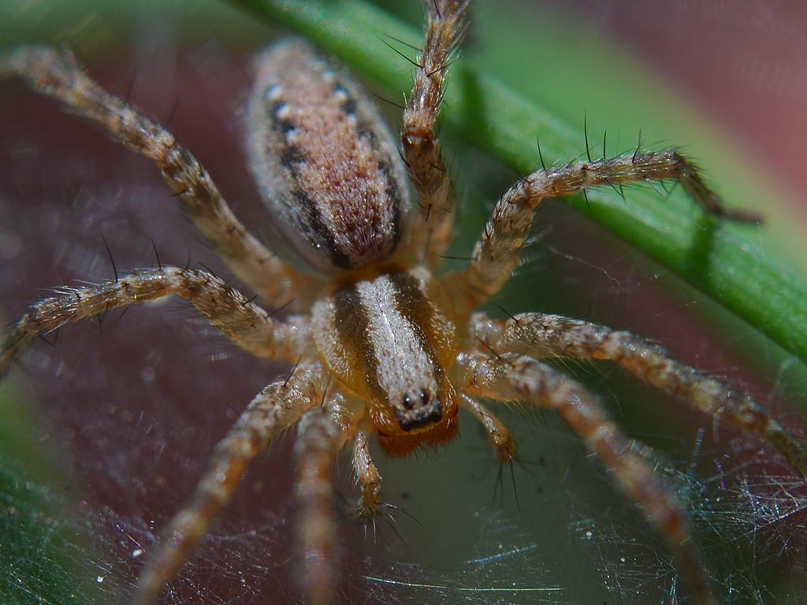
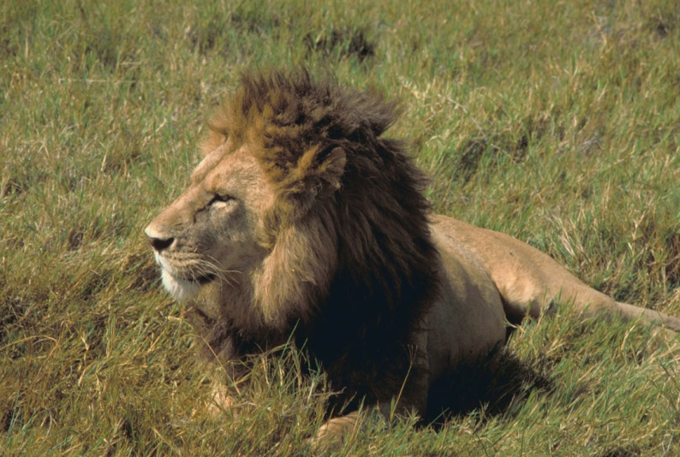
REVISION
ELEPHANT
SPIDER
LION

Slide 12
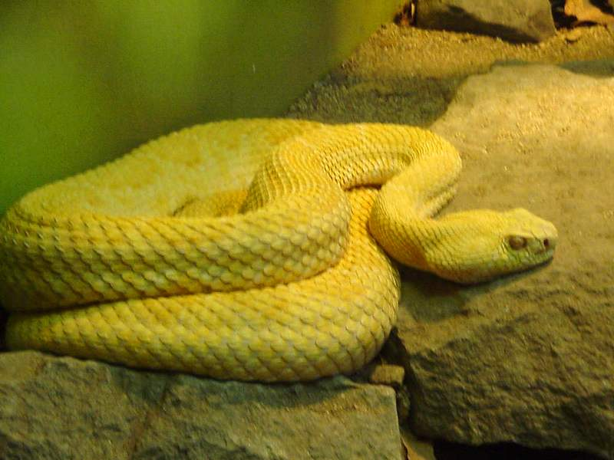
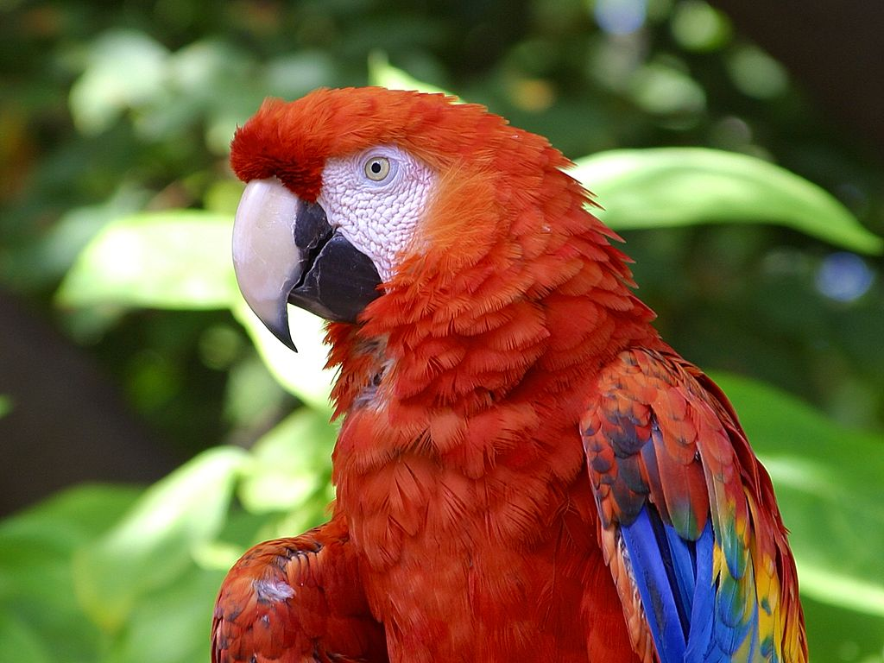
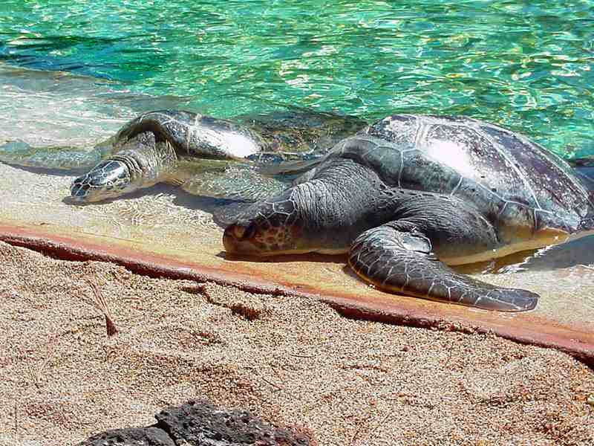
REVISION
GIRAFFE
SNAKE
PARROT
TURTLE

Slide 13
Zdroje:
www.pdphoto.org
www.commons.wikimedia.org
www.openphoto.net

